Slide 1
Kingsley Peter Moody
22nd February 1952
– 19th November 2020

Slide 2
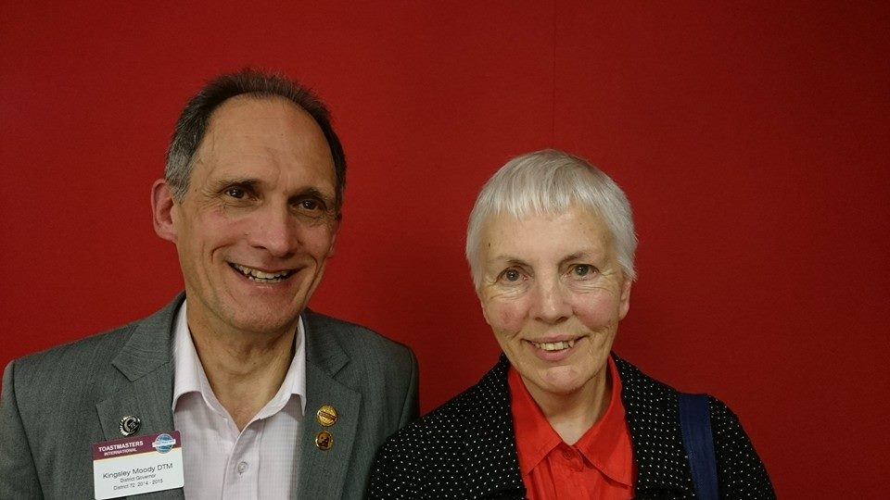
Jane Atkinson and Kingsley Moody

Slide 3
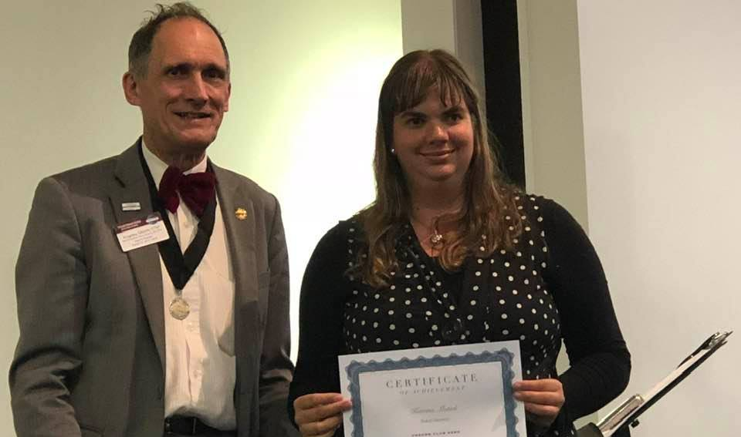
Katrina and Kingsley, a powerful duo

Slide 4
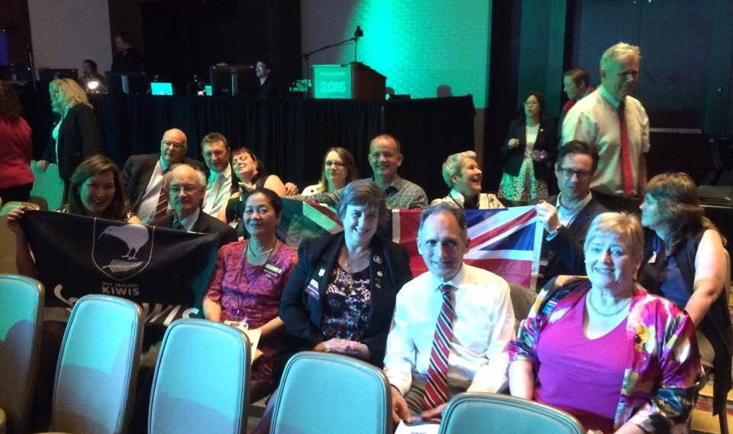
Toastmasters Washington Convention – what a blast!

Slide 5
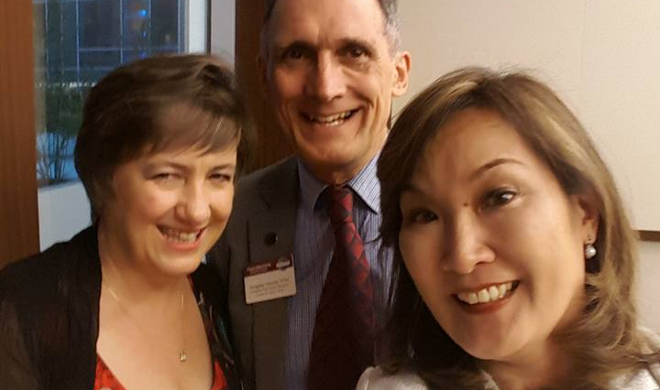
Times with Naomi are always fun!

Slide 6
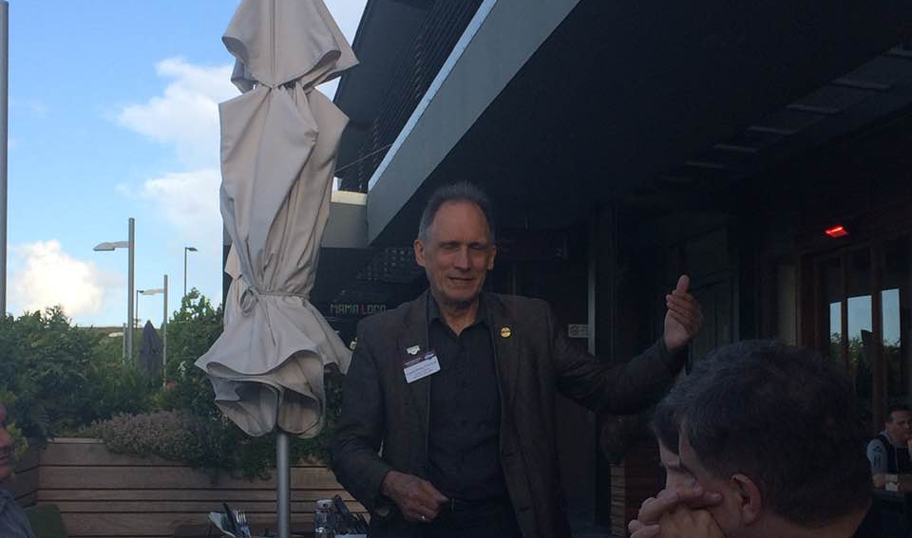
..and on my left

Slide 7
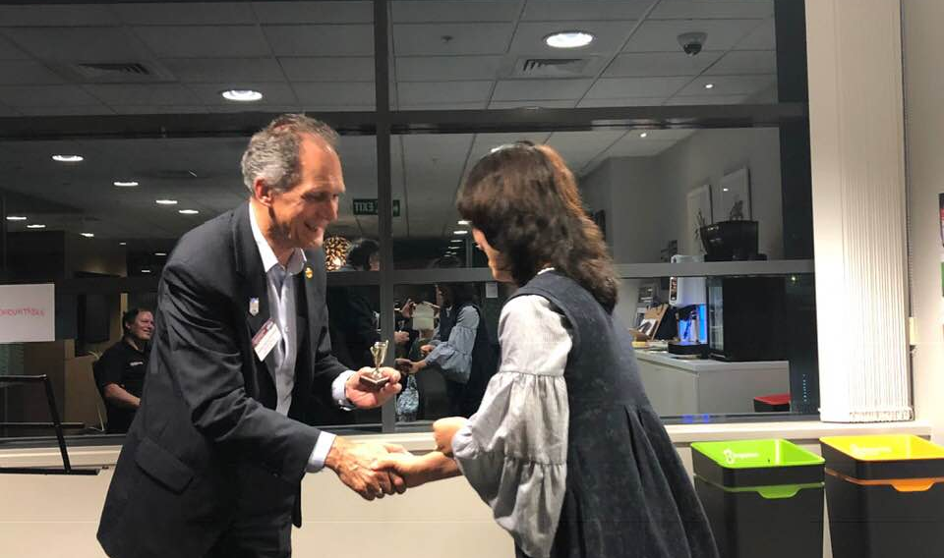
Forever giving recognition

Slide 8
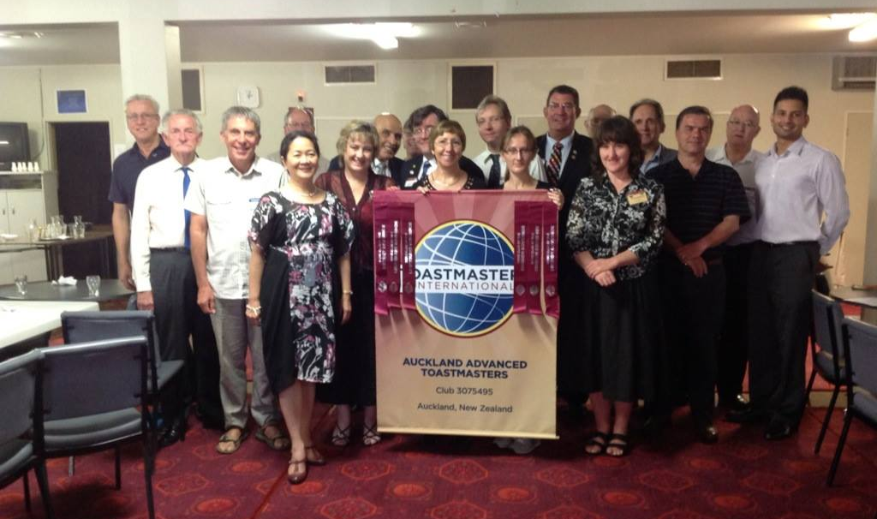
Auckland Advanced Toastmasters
Charter Luncheon

Slide 9
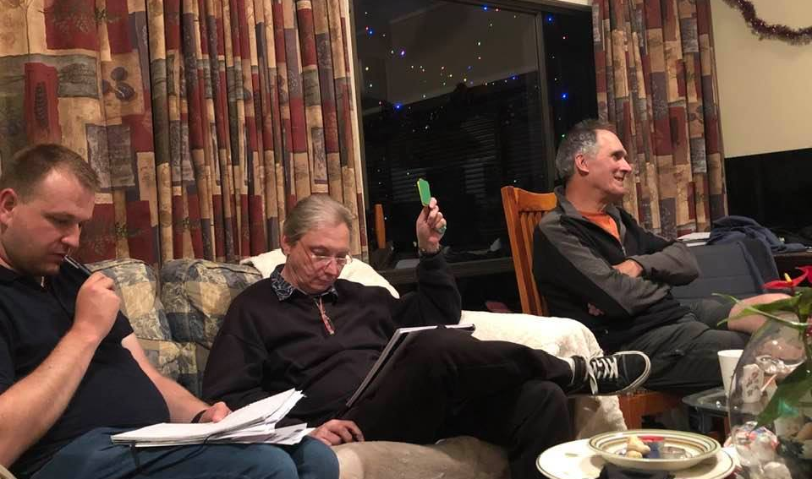
A moment in time –
Review Toastmasters

Slide 10
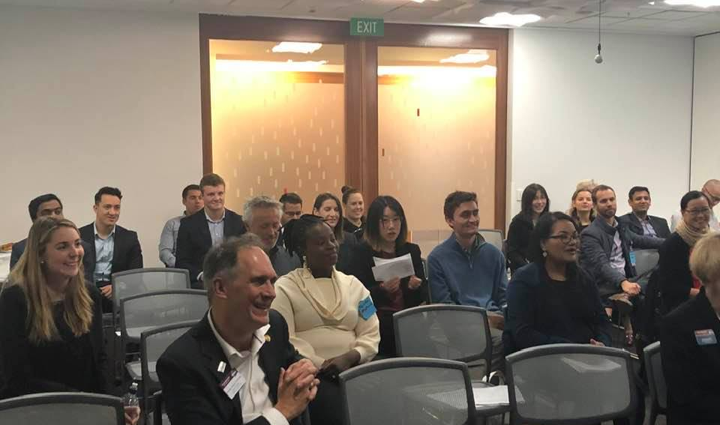
Happy and smiling as ever

Slide 11
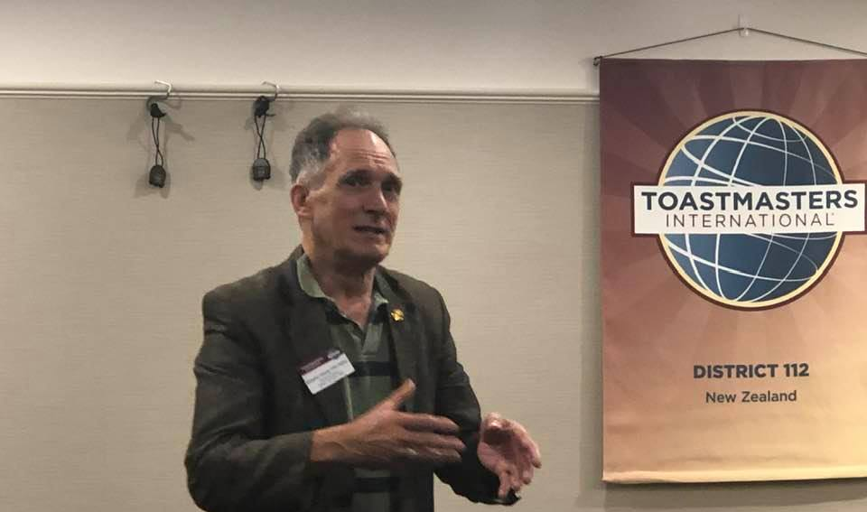
Our District 112 Legend

Slide 12
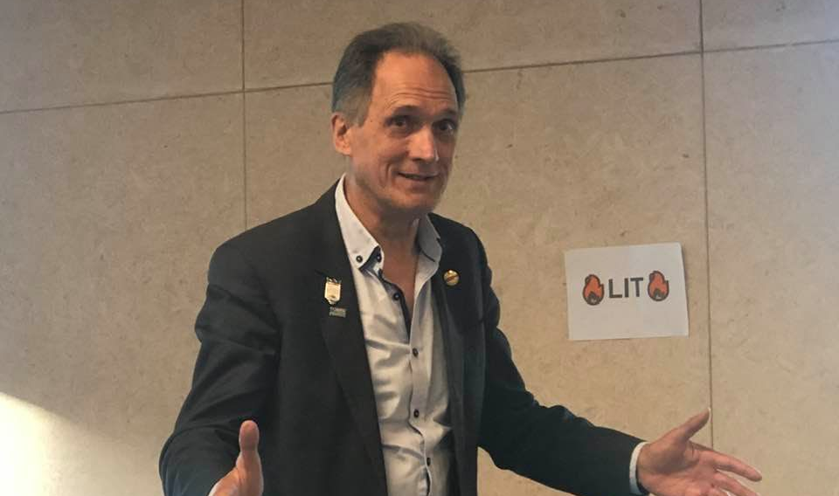
Toastmasters lit a fire in me (WOD) ☺

Slide 13
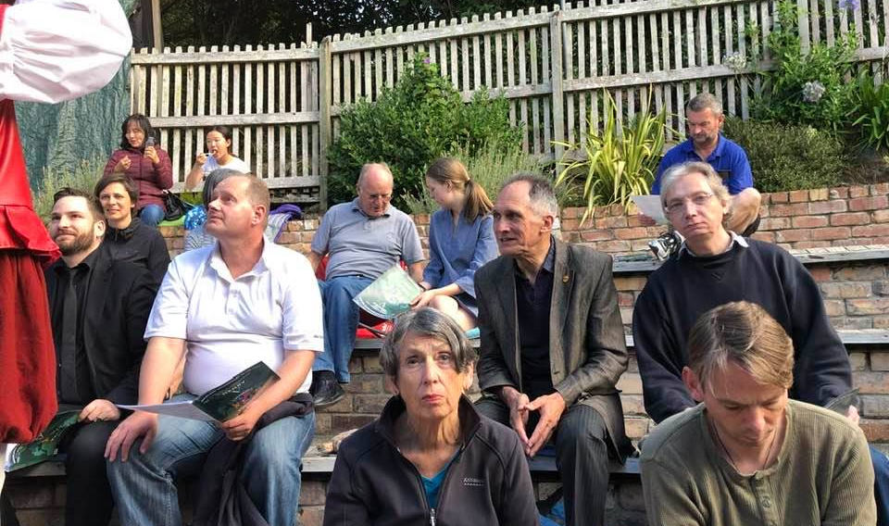
Review Toastmasters Club meeting event – Summer Shakespeare

Slide 14
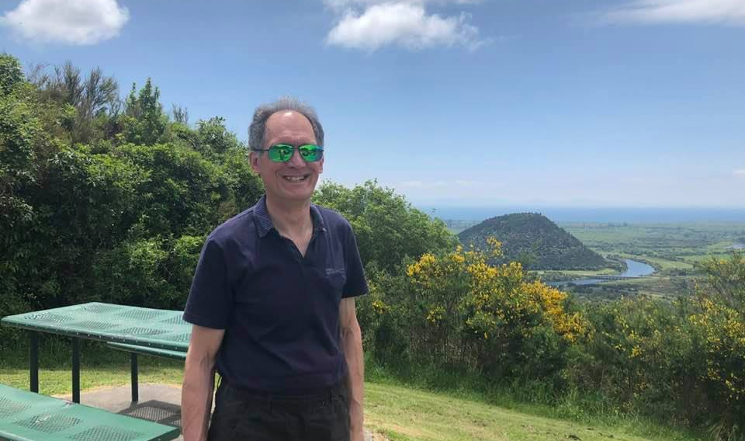
You gotta wear shades

Slide 15
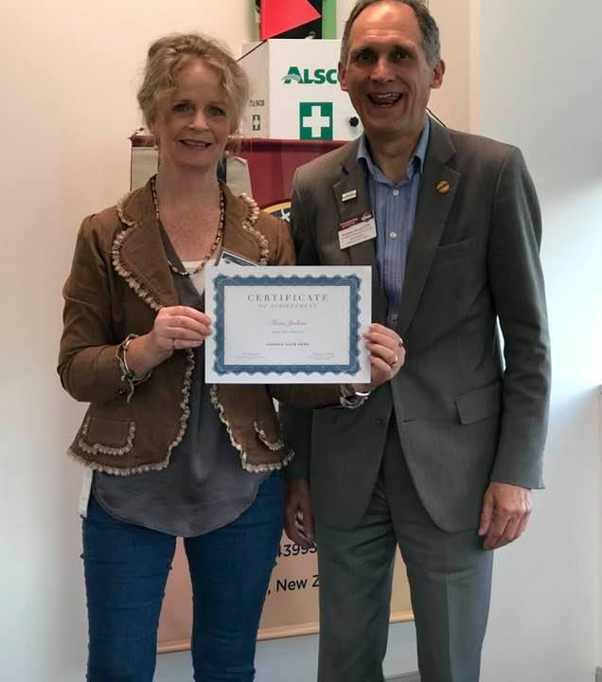
Fiona from Ingram Micro Toastmasters Club always made Kingsley smile!

Slide 16
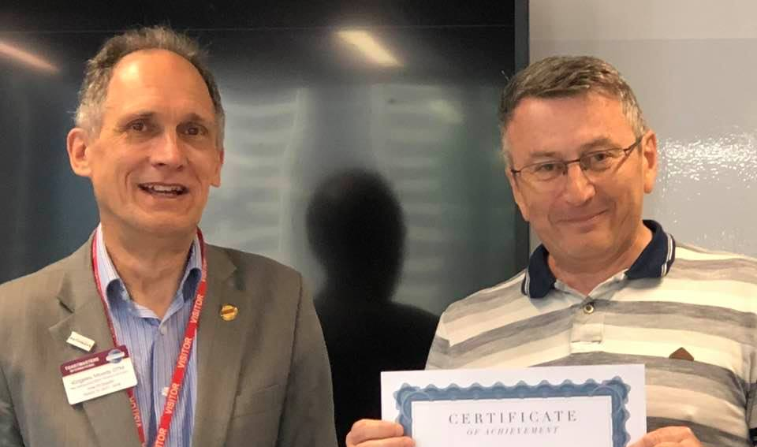
Jules from
WNZL Toastmasters Club

Slide 17
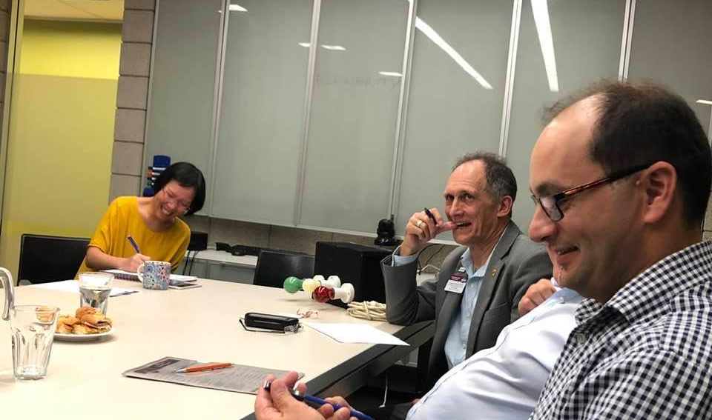
Those sossies rolls look good!

Slide 18
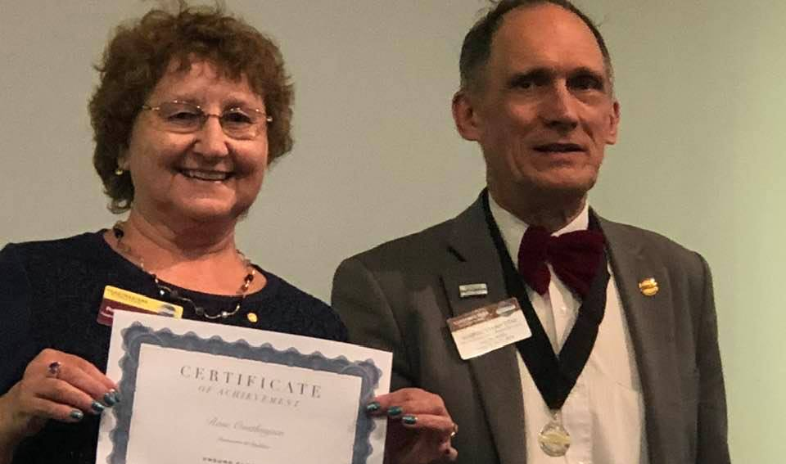
Rose and Kingsley a friendship of over 20 years

Slide 19
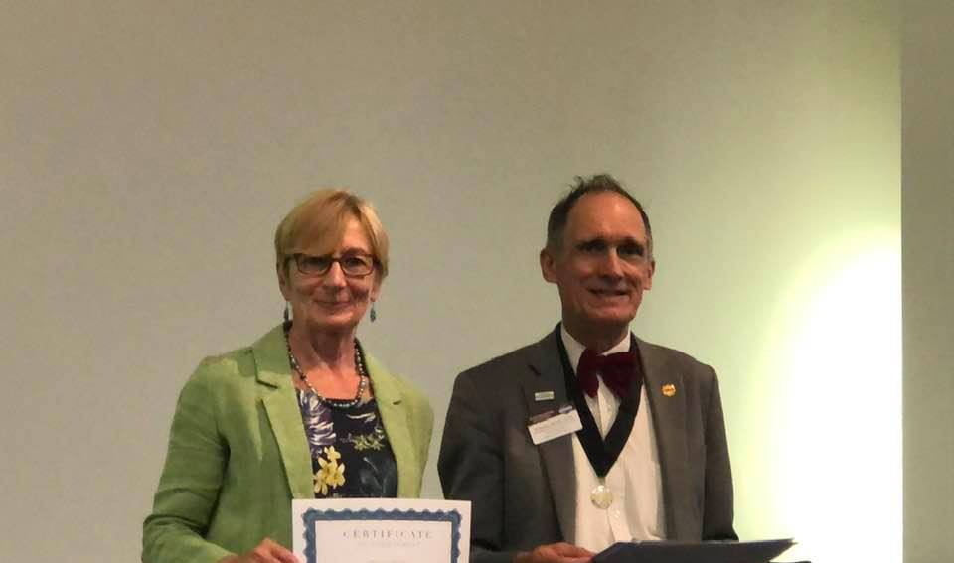
Congratulations Felicity!

Slide 20
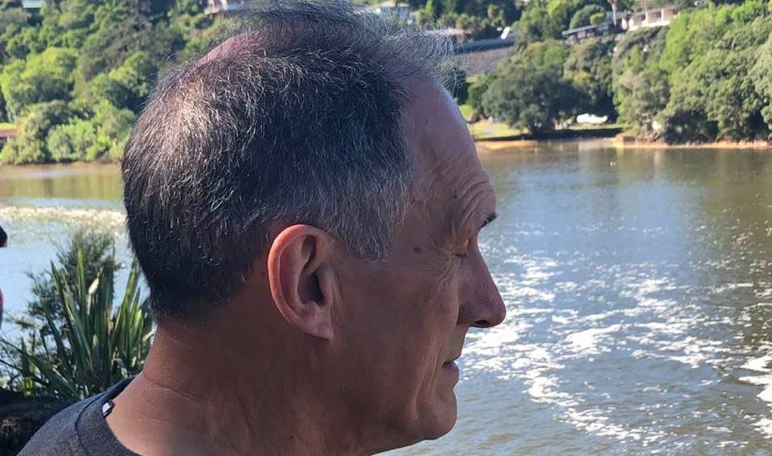
A moments reflection

Slide 21
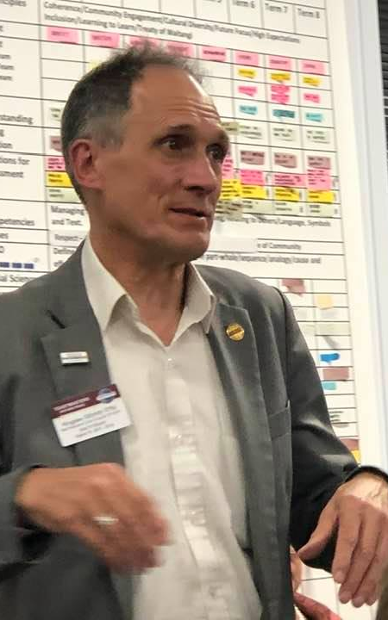
Seriously, you are not Pathways enrolled?

Slide 22
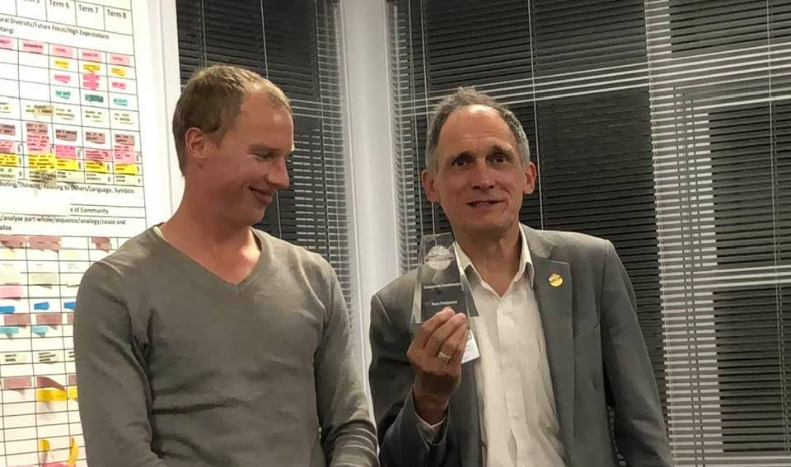
Well deserved Dylan!

Slide 23
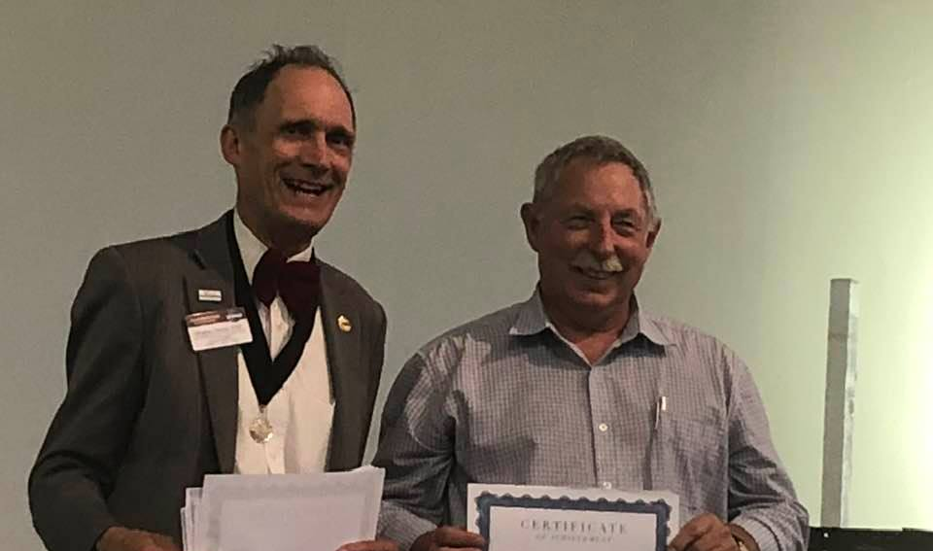
The big badge man!!!!

Slide 24
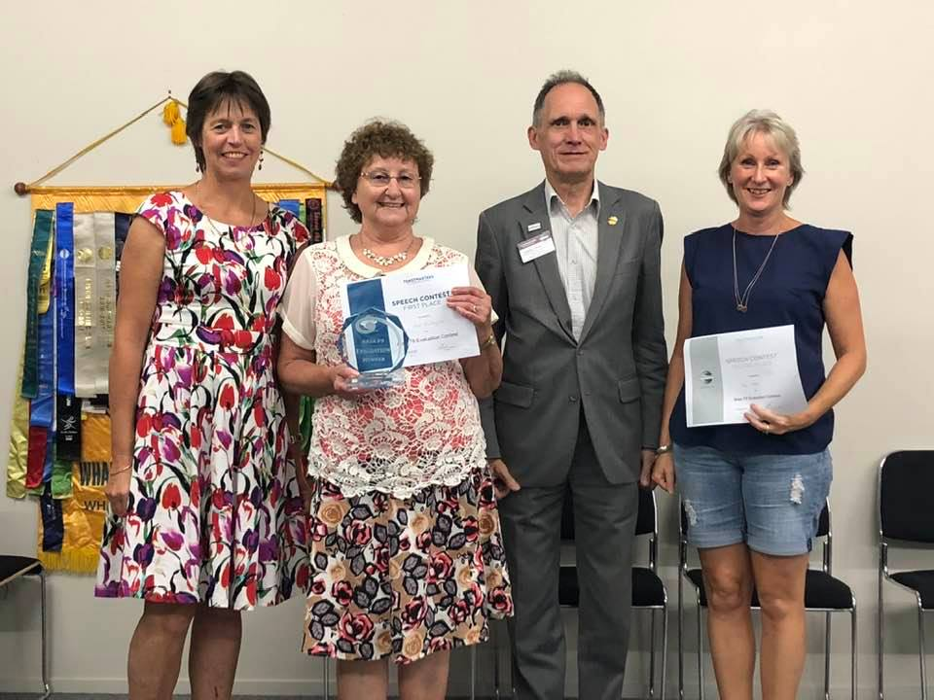
Always standing tall

Slide 25
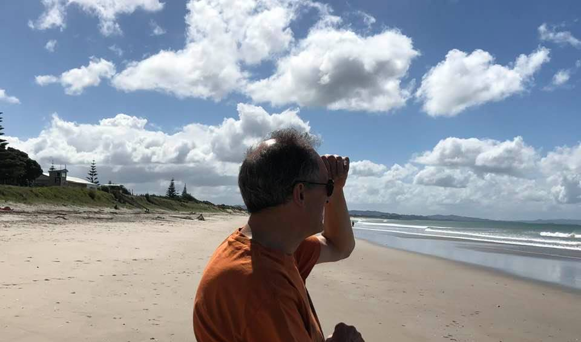
I think I can just about see it......

Slide 26
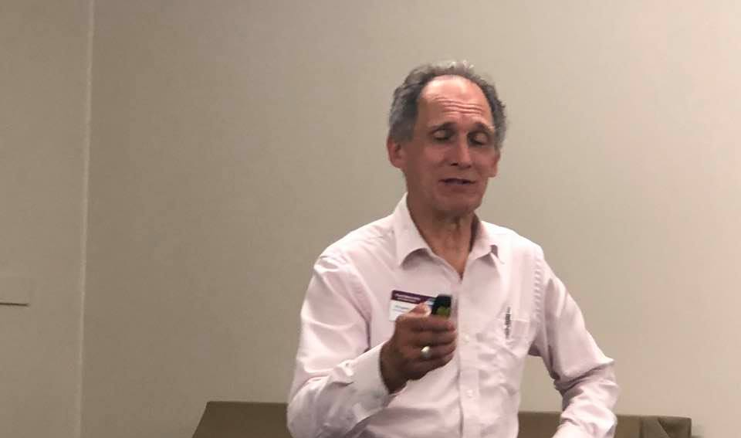
A classic Kingsley pose

Slide 27
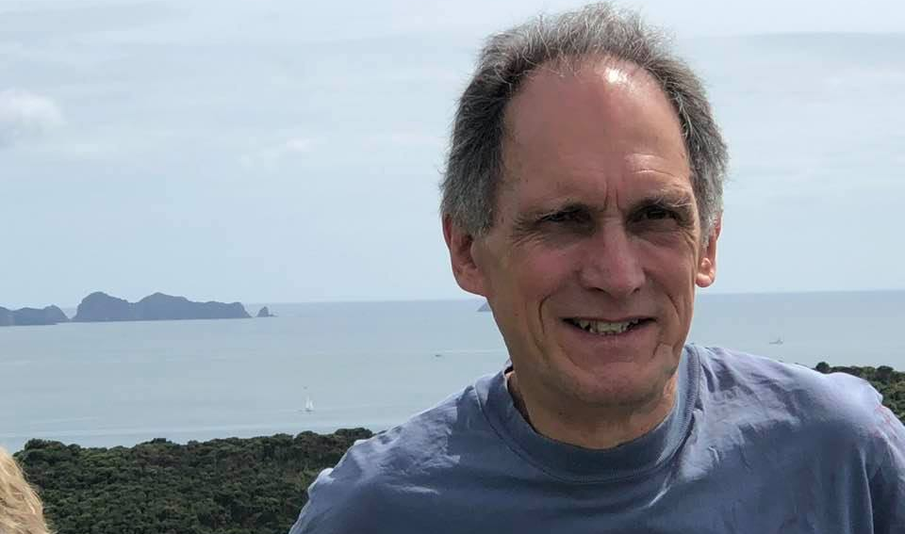
Some serious thinking!

Slide 28
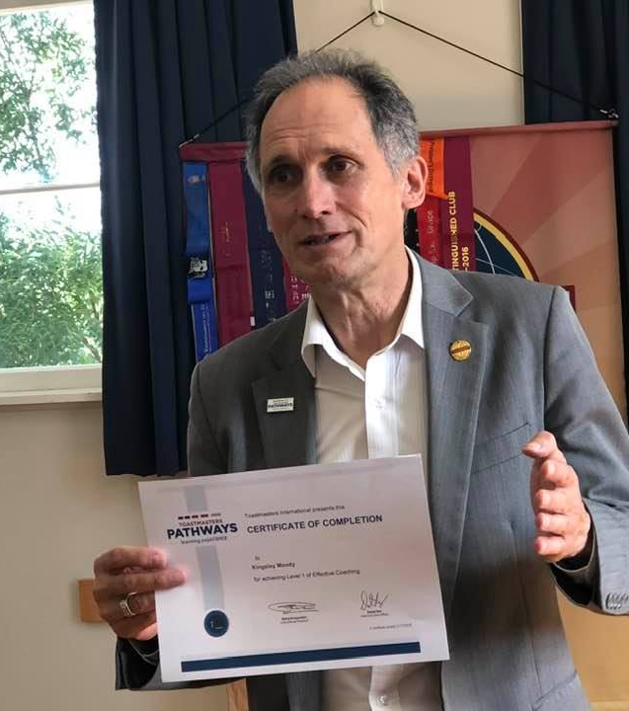
The Master at work…

Slide 29
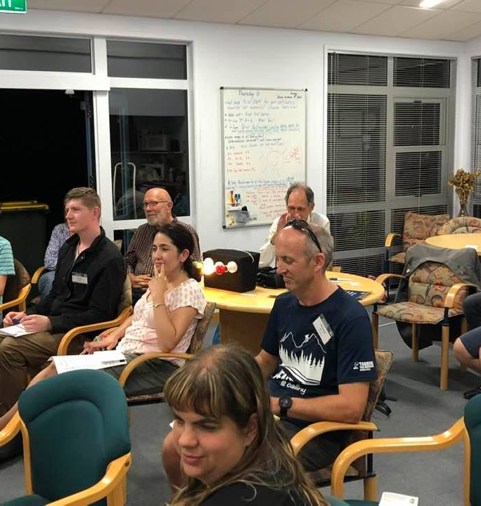
Working those lights…

Slide 30
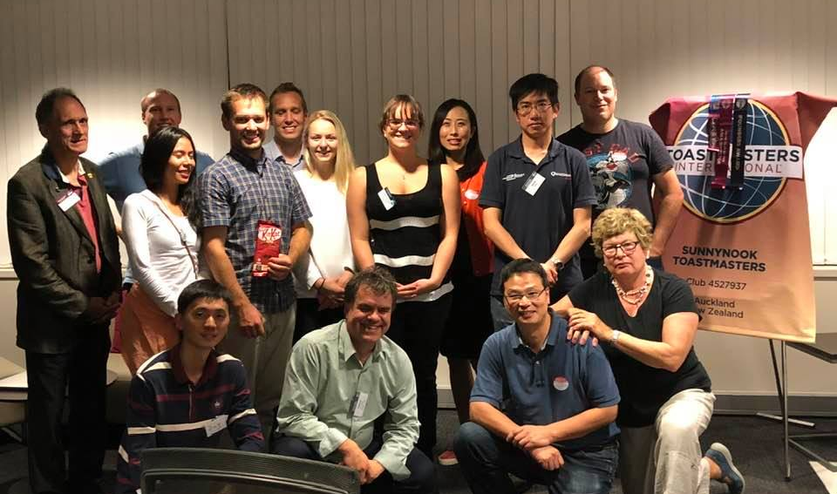
Loyal to the end at Sunnynook Toastmasters Club

Slide 31
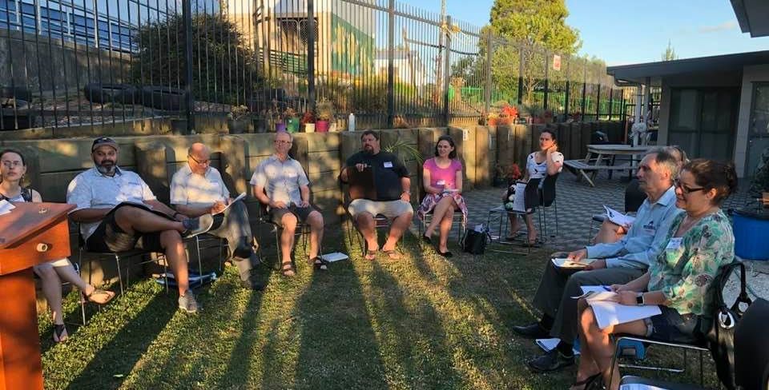
Embracing nature at West Harbour Toastmasters Club

Slide 32
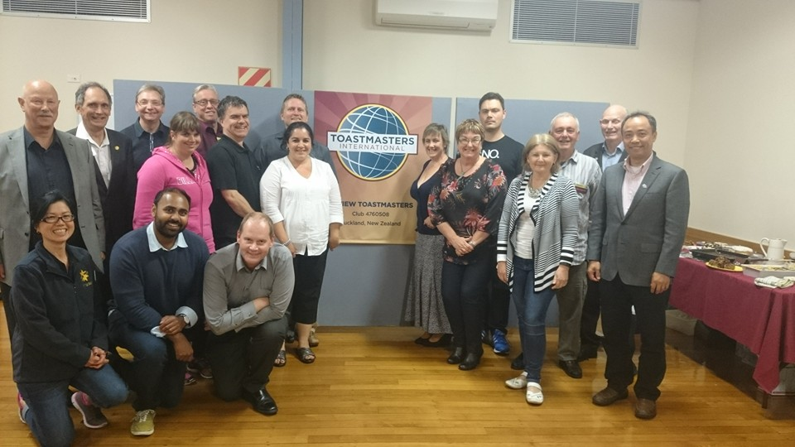
Review Toastmasters
Charter function

Slide 33
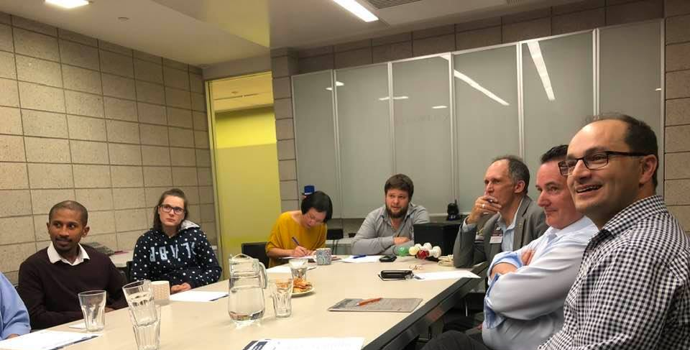
Is that really possible?

Slide 34
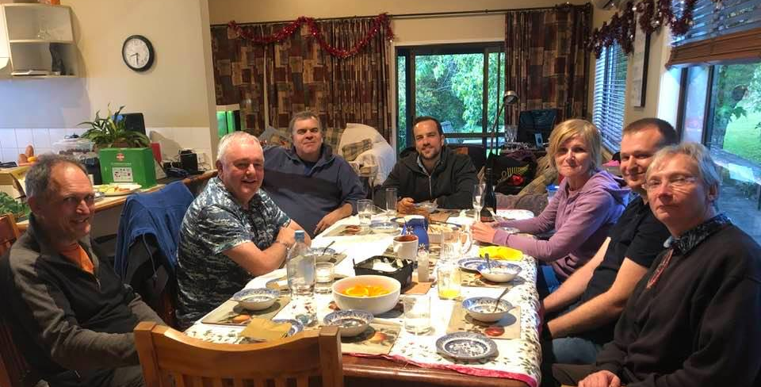
Dinner with friends =
Review Toastmasters

Slide 35
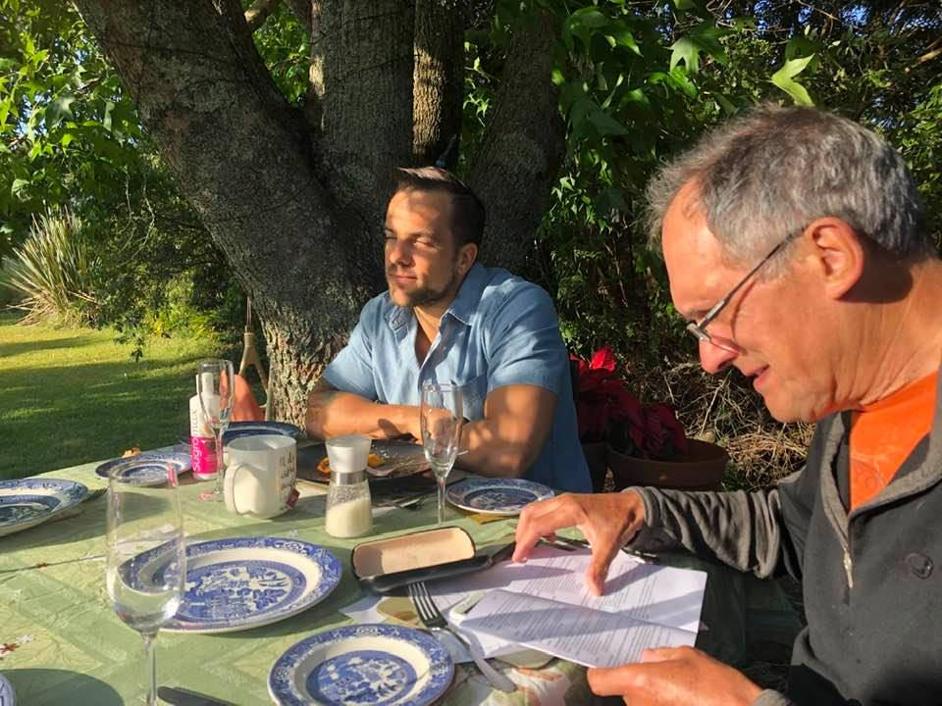
That Pathways booklet always to hand!
(Thanks Alun)

Slide 36
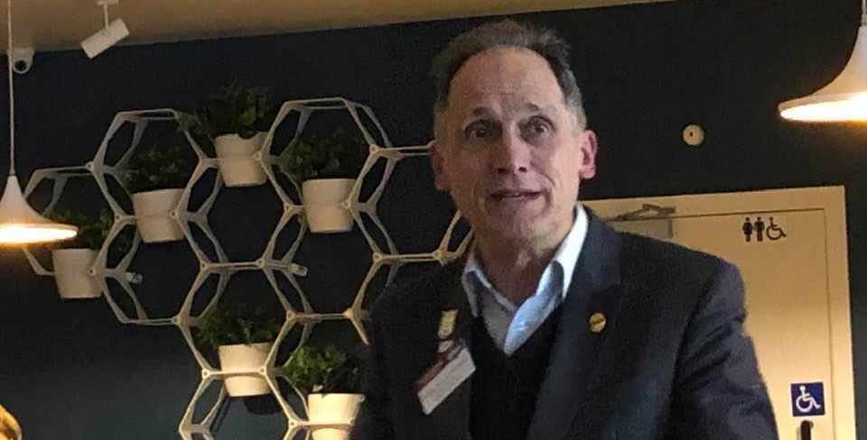
Forever eloquent

Slide 37
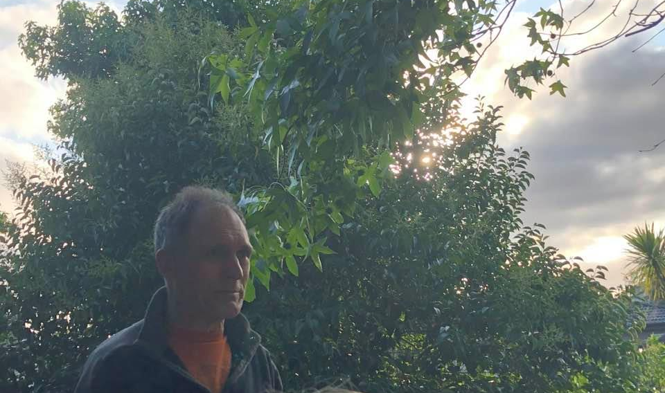
Lost in thought

Slide 38
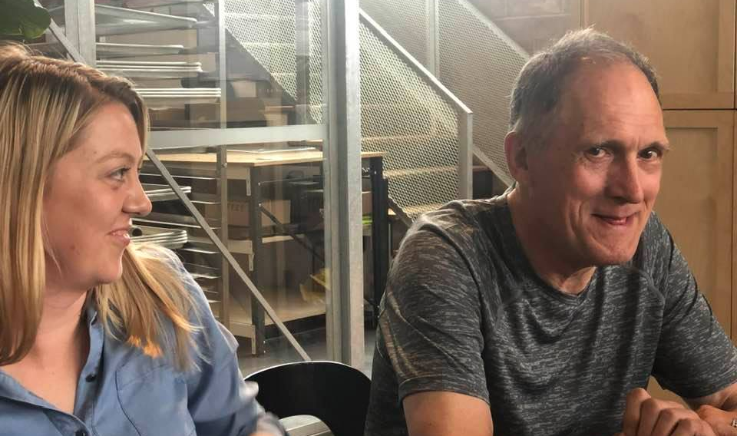
I reckon I know the answer to this one!

Slide 39
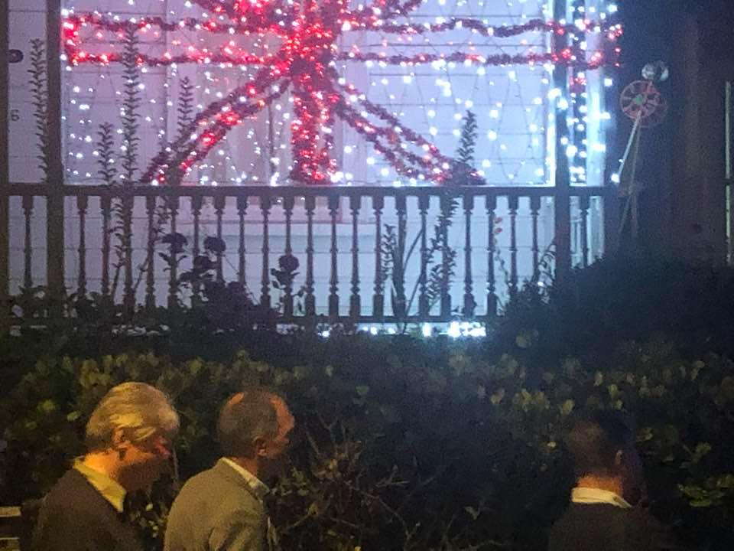
Two past DG’s in
Franklin Street

Slide 40
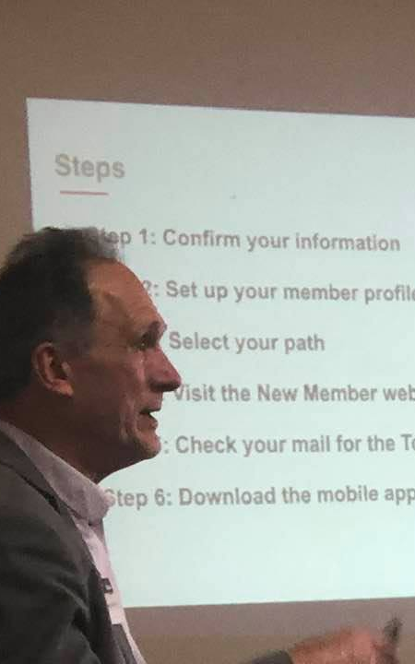
Showing you how… every step of the way…

Slide 41
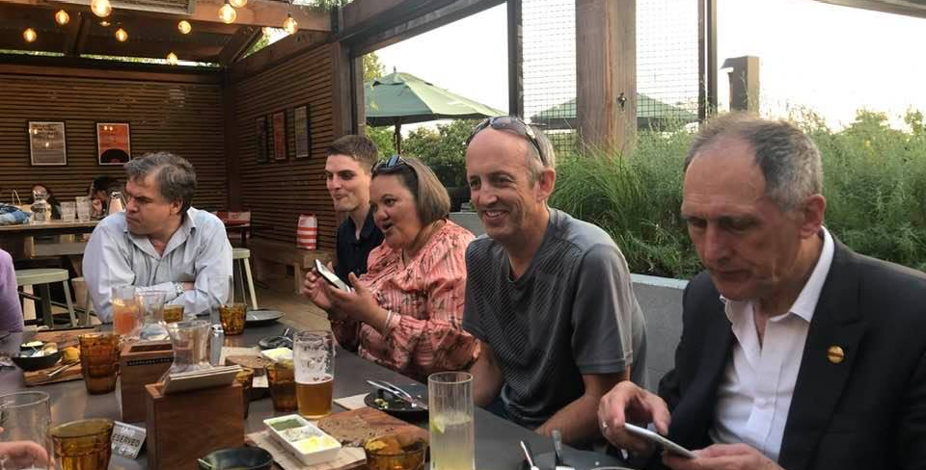
...a quick calls between courses!

Slide 42
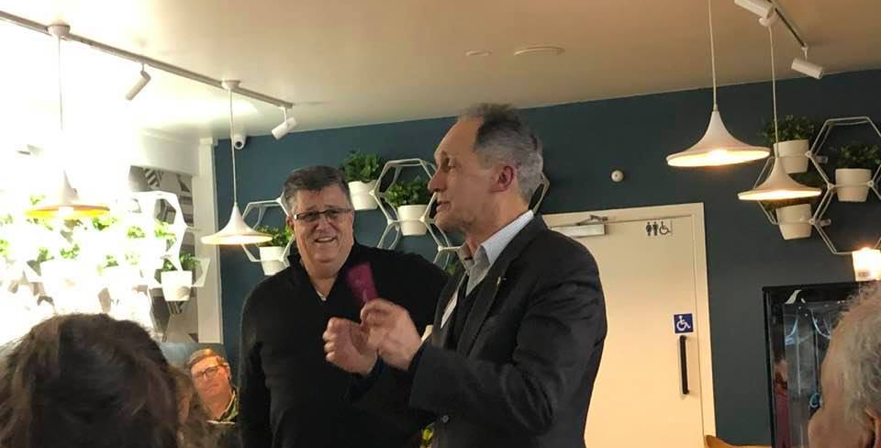
Conducting…

Slide 43
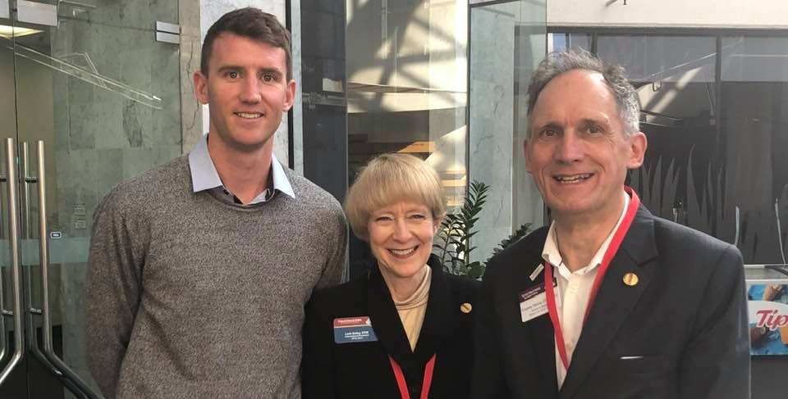
The long and short of it at Legendairy Toastmasters

Slide 44
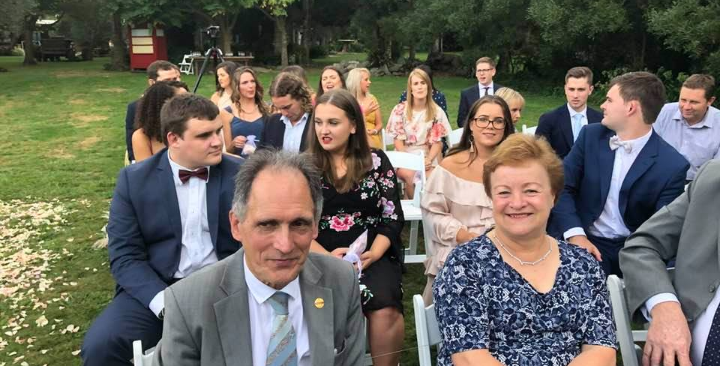
Celebrating Tom and Justine’s wedding

Slide 45
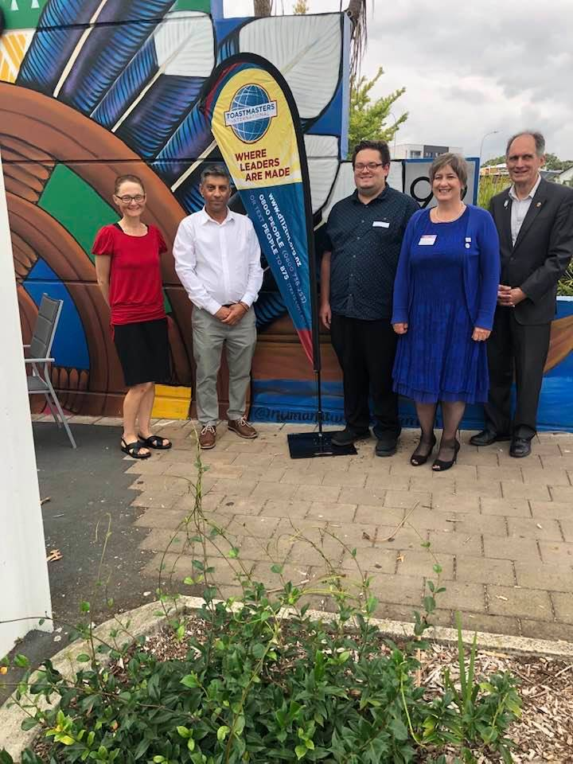
Where leaders are made

Slide 46
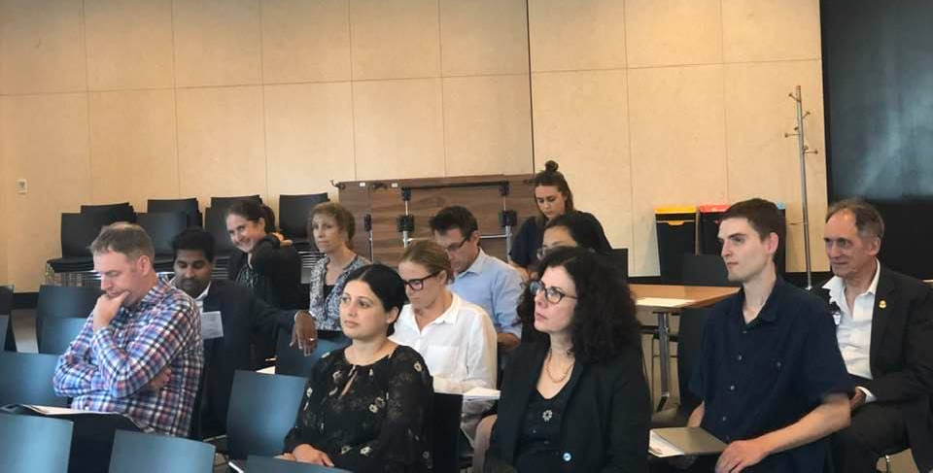
Watching quietly from the back

Slide 47
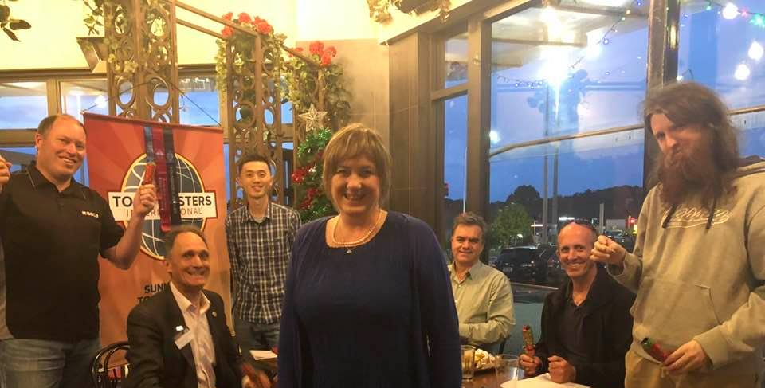
Sunnynook Toastmasters,where lifetime friendships are made

Slide 48
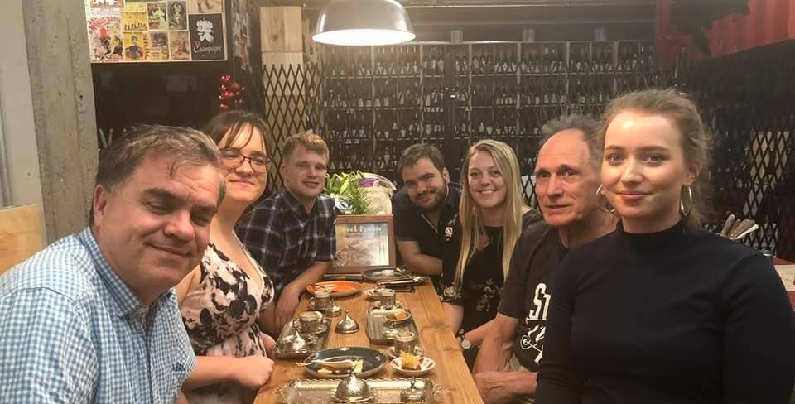
Nothing better than good Turkish coffee!

Slide 49
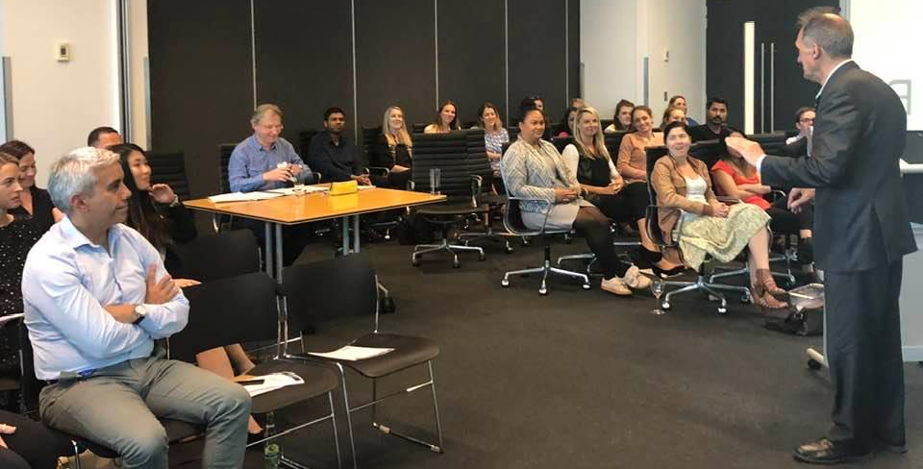
Orators of Demosthenes in the making.

Slide 50
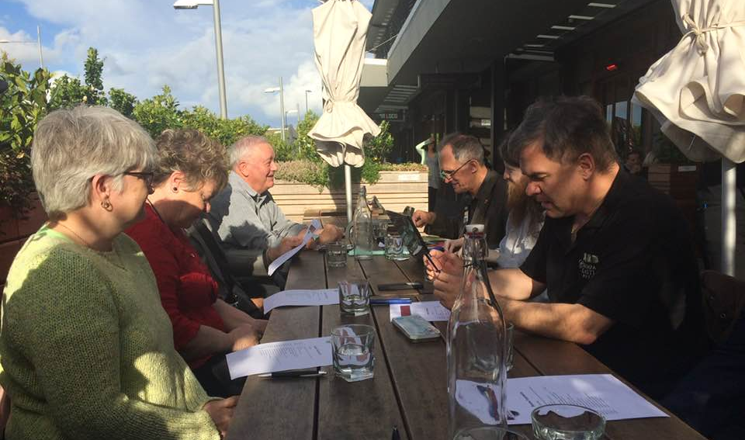
He told David…
“Watch This Space”

Slide 51
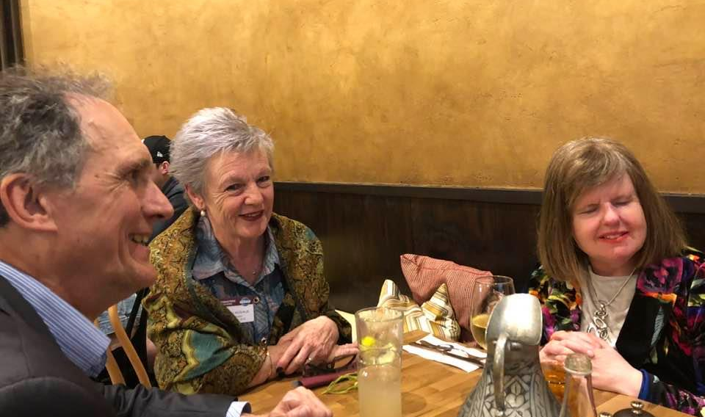
Helen and Kylee bringing out that ever cheerful smile

Slide 52

I grew up here…

Slide 53

Taking shots at District Training!

Slide 54

It’s a matter of perspective!

Slide 55

Our Golden PIP and Division F Director presenting Kingsley’s Distinguished Area Director 2017/18 award

Slide 56

St Clair Beach, Dunedin, 2016

Slide 57

Dan Coomey Shield – twice in a row!

Slide 58

Watch This Space
Charter function

Slide 59


Slide 60

Presentation of Corporate Award to Fonterra

Slide 61

WNZL Toastmasters

Slide 62


Slide 63
Academic Toastmasters

Slide 65


Slide 66


Slide 67

Kingsley’s trusted car that ferried our billboards everywhere!

Slide 68


Slide 69


Slide 70


Slide 71


Slide 72


Slide 73


Slide 74


Slide 75


Slide 76

Whatever did you say Elo and Suzy!

Slide 77


Slide 78


Slide 79


Slide 80


Slide 81


Slide 82


Slide 83


Slide 84


Slide 85


Slide 86


Slide 87


Slide 88


Slide 89


Slide 90


Slide 91


Slide 92


Slide 93


Slide 94


Slide 95


Slide 96


Slide 97


Slide 98


Slide 99


Slide 100


Slide 101


Slide 102


Slide 103


Slide 104


Slide 105


Slide 106


Slide 107


Slide 108


Slide 109


Slide 110


Slide 111


Slide 112


Slide 113


Slide 114


Slide 115


Slide 116


Slide 117


Slide 118


Slide 119


Slide 120


Slide 121


Slide 122


Slide 123


Slide 124


Slide 125


Slide 126


Slide 127


Slide 130


Slide 131


Slide 132


Slide 133


Slide 134

Empire State Building

Slide 135

The pleasure of overseas travel!

Slide 136

Pathways in 2016 in Washington

Slide 137


Slide 138


Slide 139


Slide 140


Slide 141


Slide 142


Slide 143


Slide 144


Slide 145


Slide 146


Slide 147


Slide 148


Slide 149


Slide 150


Slide 151


Slide 152


Slide 153


Slide 154


Slide 155


Slide 156


Slide 157


Slide 158


Slide 159


Slide 160


Slide 162


Slide 163


Slide 164


Slide 165


Slide 166


Slide 167


Slide 168


Slide 169


Slide 170


Slide 171


Slide 172


Slide 173


Slide 174


Slide 175


Slide 176


Slide 177


Slide 178


Slide 179


Slide 180

Friendship build on a solid foundation lasts forever

Slide 181


Slide 182


Slide 183


Slide 184


Slide 185


Slide 186


Slide 187


Slide 188


Slide 189


Slide 190


Slide 191


Slide 192


Slide 193


Slide 194


Slide 195


Slide 196


Slide 197


Slide 198


Slide 199


Slide 200


Slide 201


Slide 202


Slide 203


Slide 204


Slide 205


Slide 206


Slide 207


Slide 208


Slide 209


Slide 210


Slide 211


Slide 212


Slide 213


Slide 214


Slide 215


Slide 216


Slide 217


Slide 218


Slide 219


Slide 220


Slide 221


Slide 222


Slide 223


Slide 224


Slide 225


Slide 226

Kingsley understood a small coffee is no good!

